Slide 1
Geometry Optimization in Q-Chem
Dr. Peter F. McLaughlin
Operations Manager Q-Chem, Inc.
Thursday, February 9th 2023

Slide 2
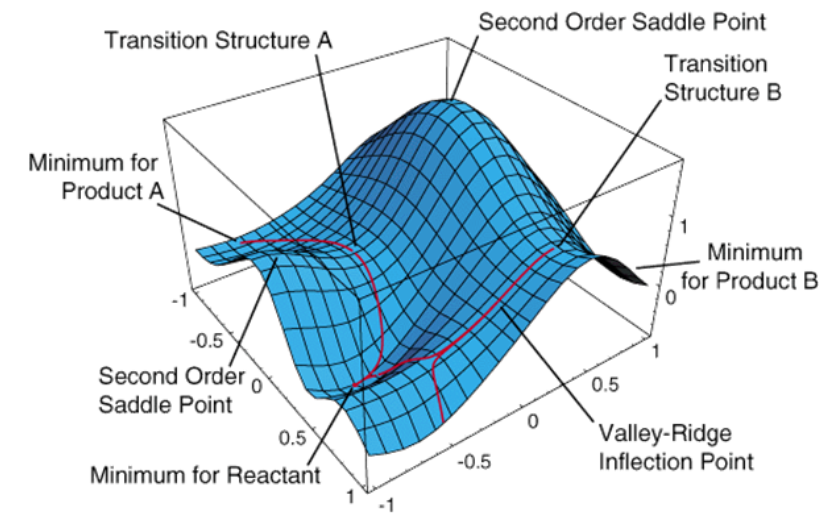
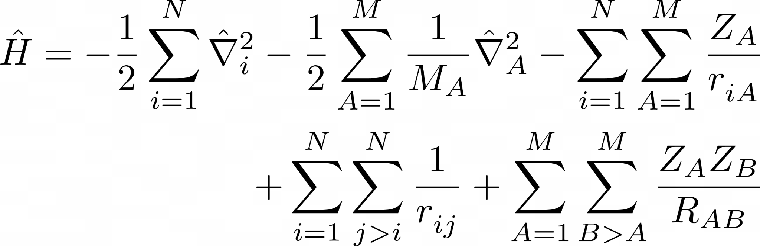
Potential Energy Surfaces
Stationary Points:
Minima and saddle points
Hratchian, H.P.; Schlegel, H.B. WIREs Comput. Mol. Sci. 2011, 1, 790-806
Notes:
Born-Oppenheimer Approximation the Electronic Schrodinger equation is dependent on different nuclear positions. The PES is then allows us to describe nuclear dynamics in which we can search for stationary points, saddle points, allow us to describe chemical reactions.

Slide 3
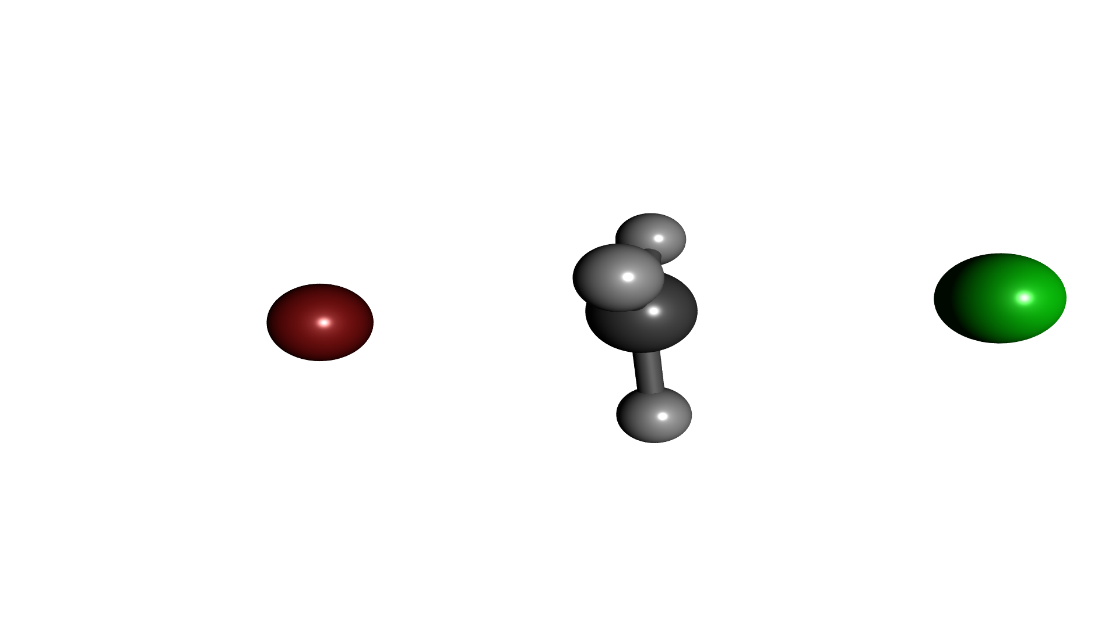
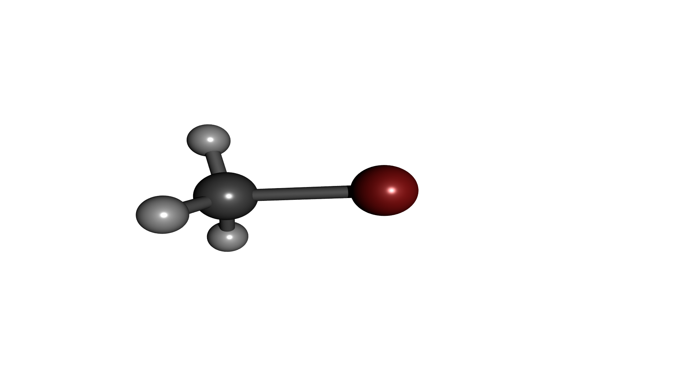
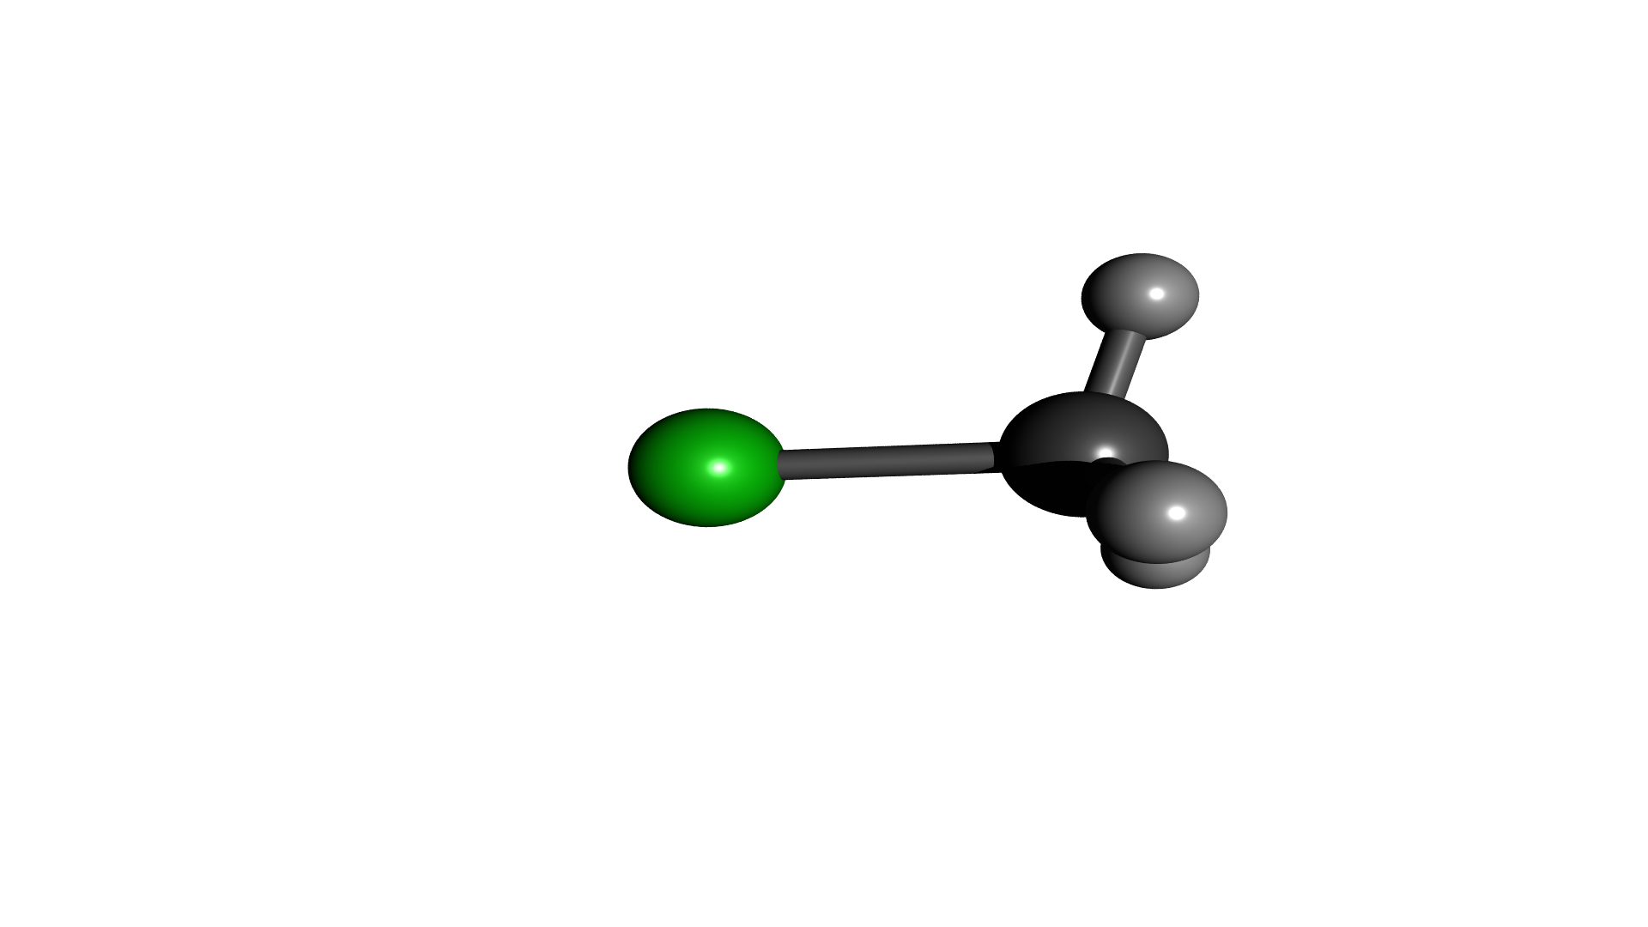
Chemical Reactions
Transition State
Products
Reactants
Reaction Barrier
Reaction Energy
Reaction Coordinate

Slide 4
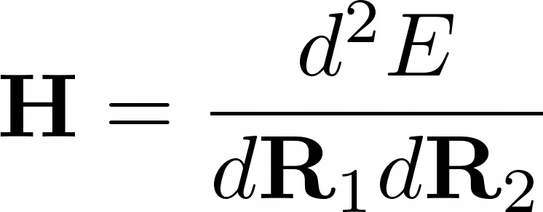
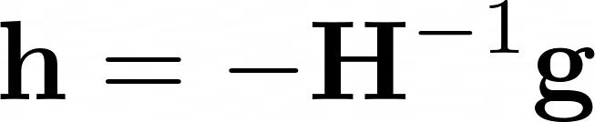
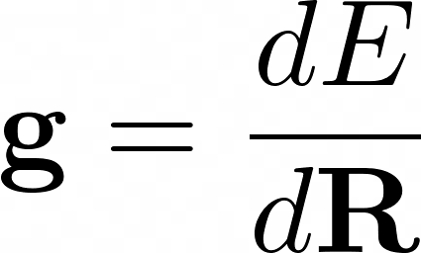
Theory
Newton-Raphson step
Gradient Vector
Hessian Matrix
Notes:
Consider the energy at some point, with a step h expanding the Taylor Series. Differentiated with respect to h, and setting the term to zero (since it would be the minimum)

Slide 5
Geometry Optimization Capabilities in Q-Chem
Cartesian, Z-Matrix or Internal Coordinates
Equilibrium Structure Searches
Constrained Optimization
Transition State Searches
Initial Hessian and Hessian update options
Intrinsic Reaction Coordinates
Minimum-energy Crossing Points along conical seams
Potential Energy Scans
Frozen String Method
Application of Pressure

Slide 6
Geometry Optimization Lab Tutorials
Ground State Optimization: Allene
Ground State Optimization and Vibrational Analysis: D-Alanine
Excited State Optimization: Allene
Transition State Optimization: SN2 Reaction of Bromide and Methyl Chloride
Potential Energy Scan: Butane

Slide 7
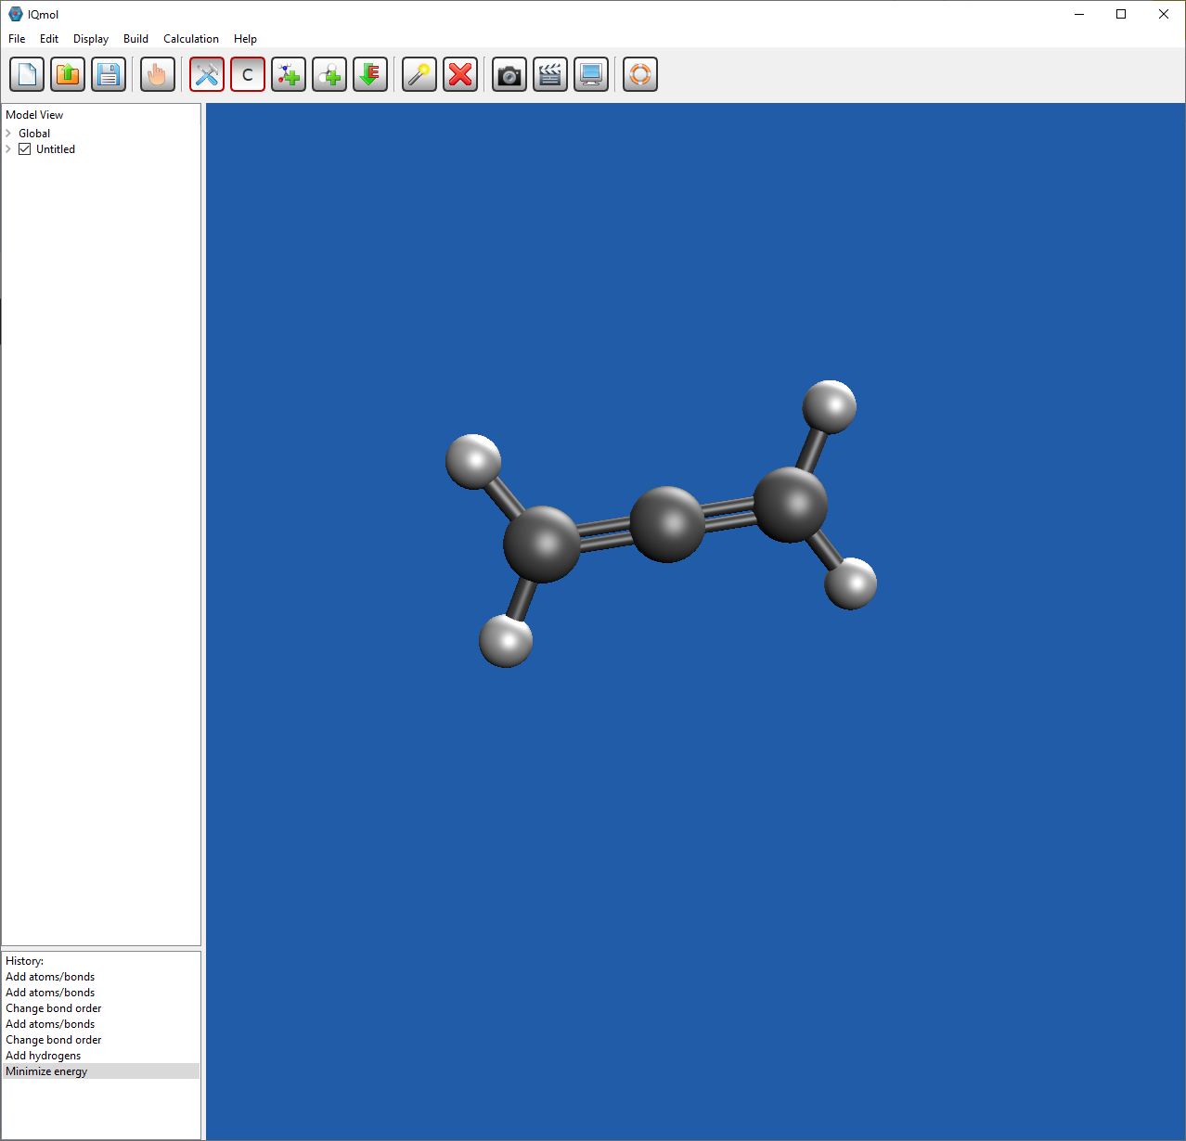
Ground State Optimization: Allene
Build using atom tool
Use “Add Hydrogen” button
Use “Minimize Energy” button
Calculation
Method: HF
Basis: STO-3g
Result:
Final energy is -114.421718912283

Slide 8
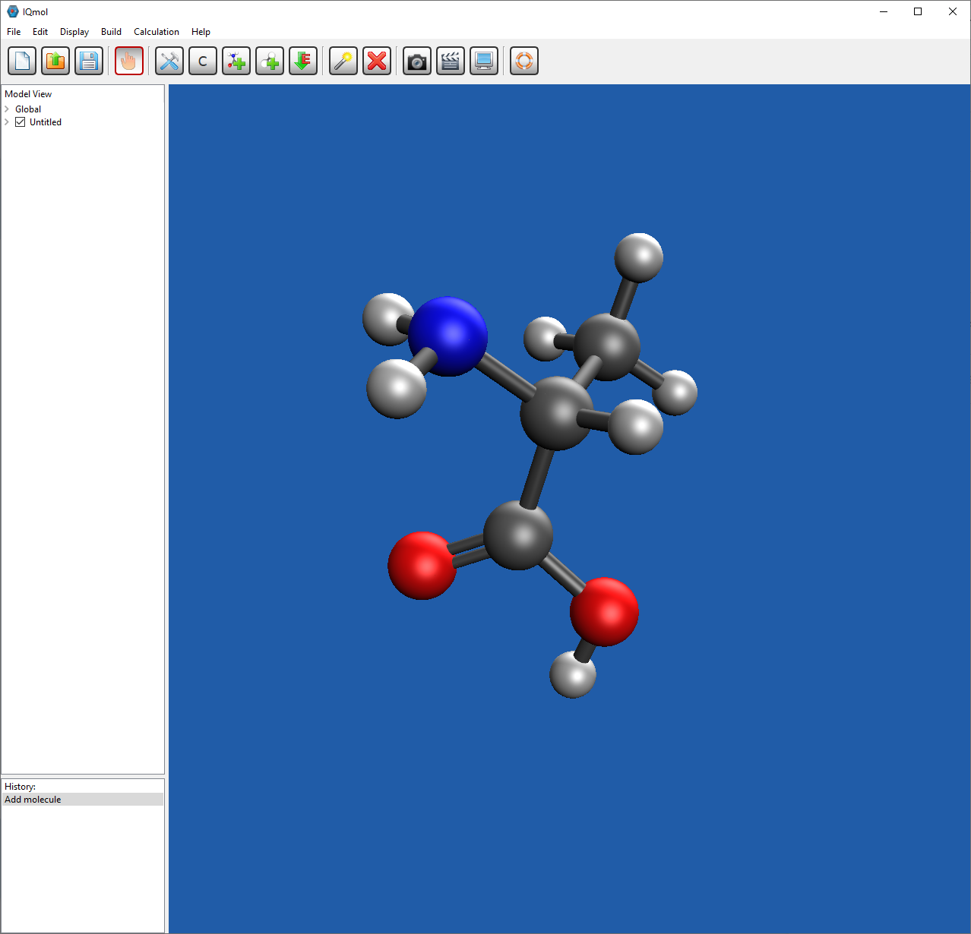
GS Optimization and Vibrational Analysis: D-Alanine
Build using Add Fragment tool
Calculation
Method: HF
Basis: 6-31G
Add to “Generated Input File:”
$geom_opt
hessian_verify = recomputed
final_vibrational_analysis = true
$end
Result:
Lowest Vibrational Frequency: 61.67 cm**-1

Slide 9
Excited State Optimization: Allene
Start from optimized structure
Calculation
Method: HF
Basis: STO-3g
Add to “Generated Input File:”
CIS_N_ROOTS = 5 !Number of Roots
CIS_SINGLETS = 1 !Calc. Singlets
CIS_TRIPLETS = 0 !No Triplets
CIS_STATE_DERIV = 1 !1st Excited State
Result:
Final energy is -114.147954045183

Slide 10
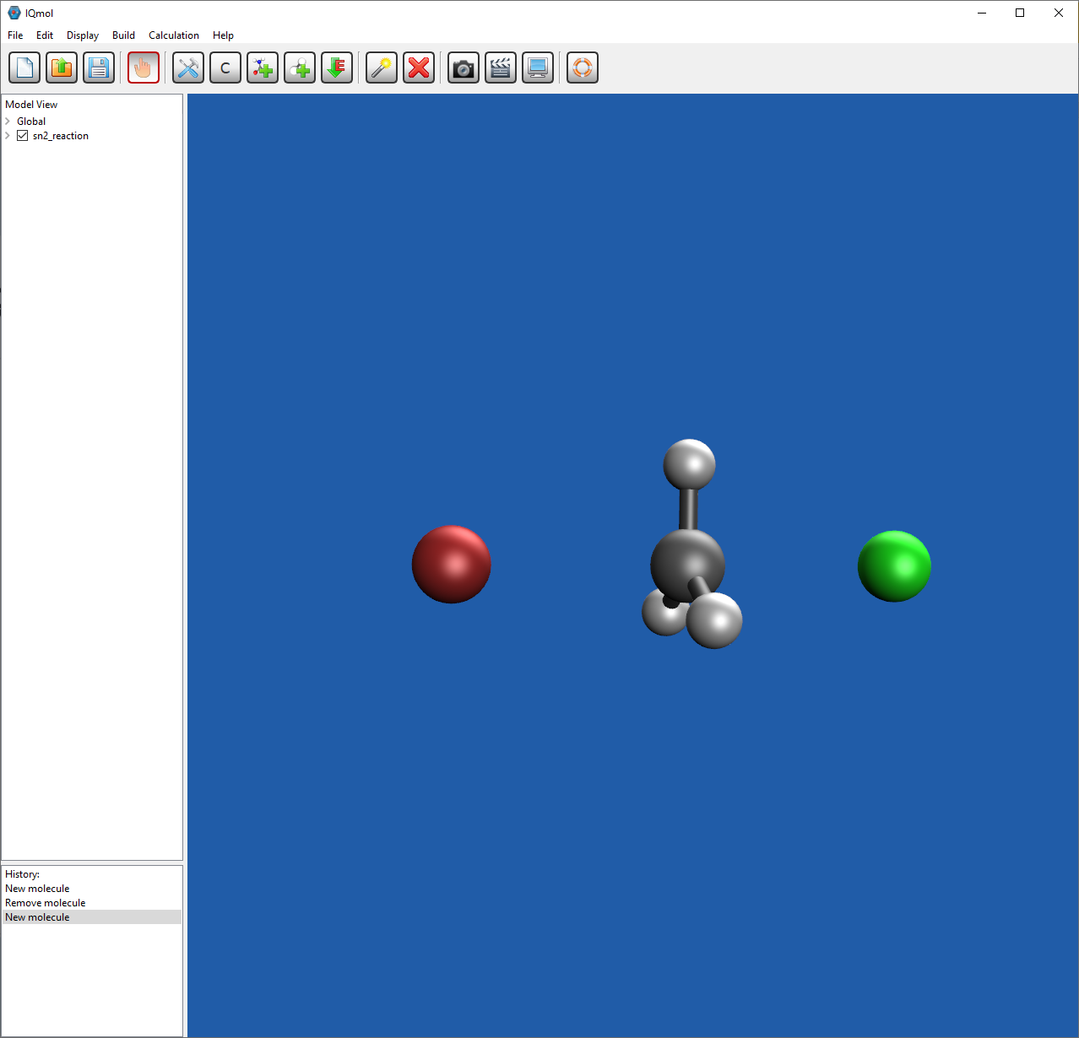
TS Optimization: SN2 Reaction of Bromide and Methyl Chloride
Draw Structure
Start with Frequency Calculation
Method: HF
Basis: 6-31G
Make sure to verify charge and multiplicity
Add to “Generated Input File:”
@@@
$molecule
read
$end
$rem
BASIS = 6-31G
GEOM_OPT_HESSIAN = Read
GUI = 2
JOB_TYPE = TS
METHOD = HF
SCF_CONVERGENCE = 8
$end
Result:
Final energy is -3071.05371984757

Slide 11
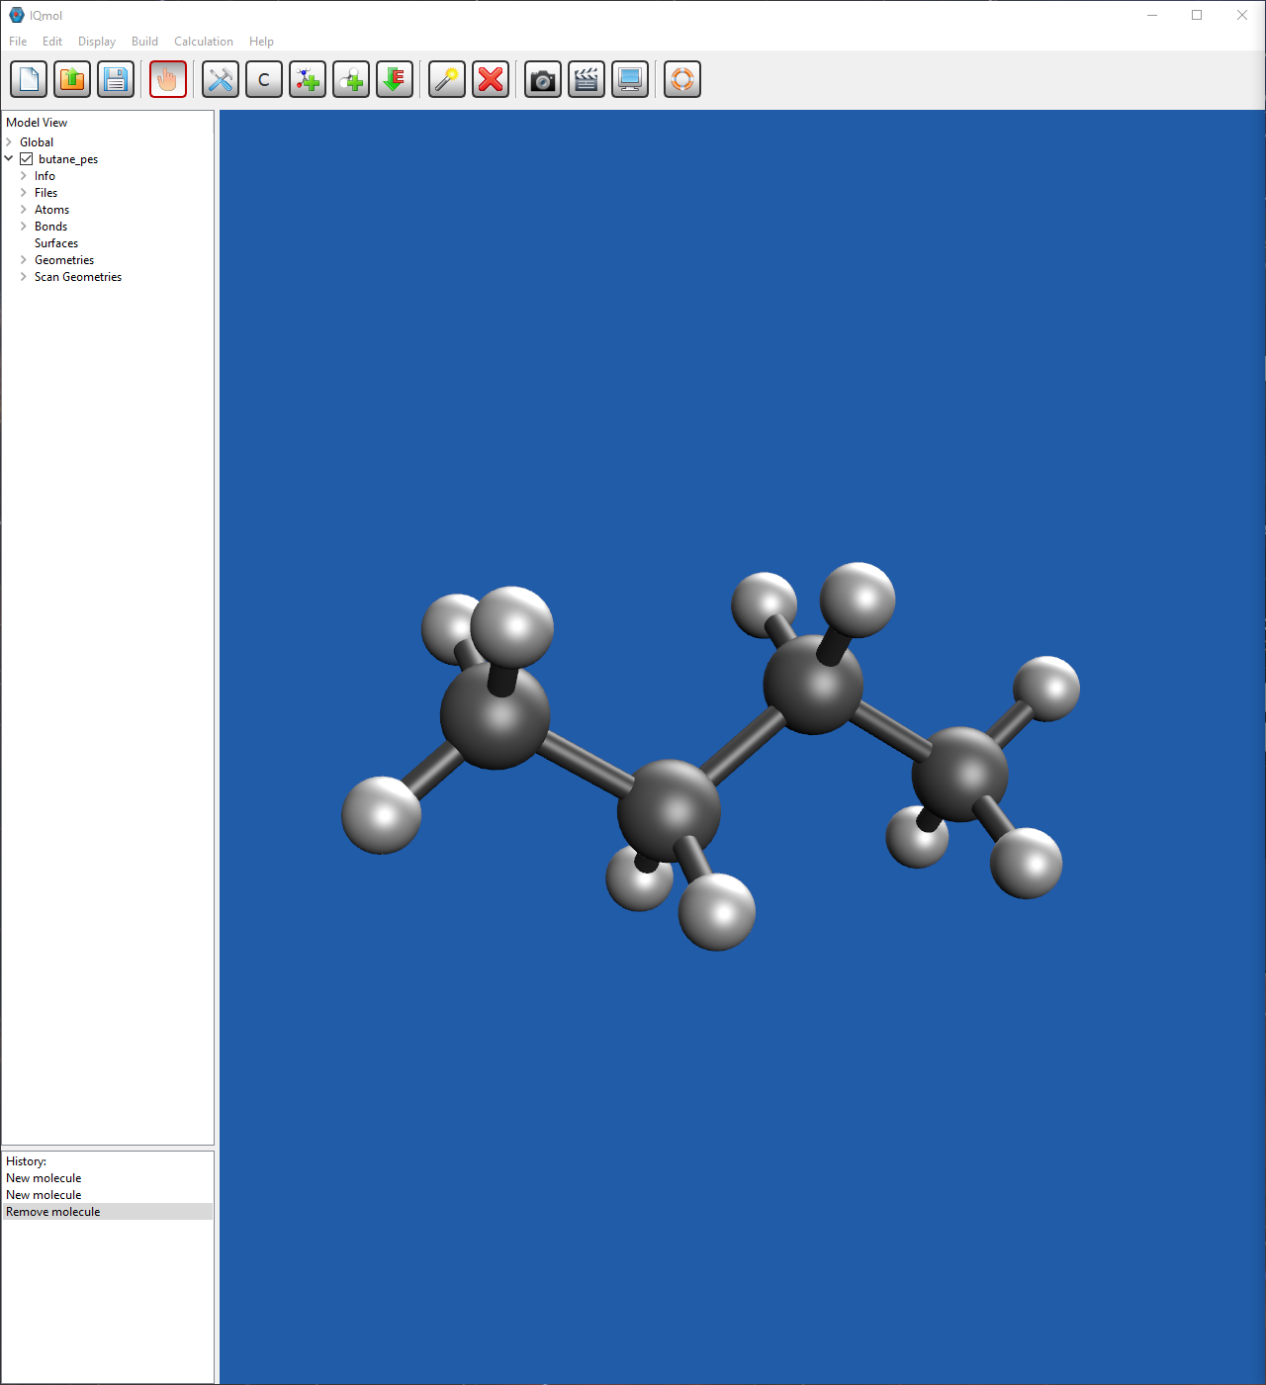
Potential Energy Scan: Butane
Take optimized structure: butane.xyz
Start PES Scan Calculation
Method: HF
Basis:STO-3G
Add to “Generated Input File:”
$scan
tors 1 2 3 4 -180 180 15
$end
Double Click Scan Geometries

Slide 12
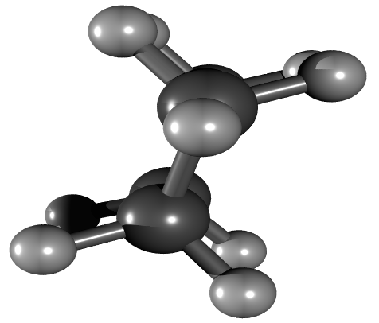
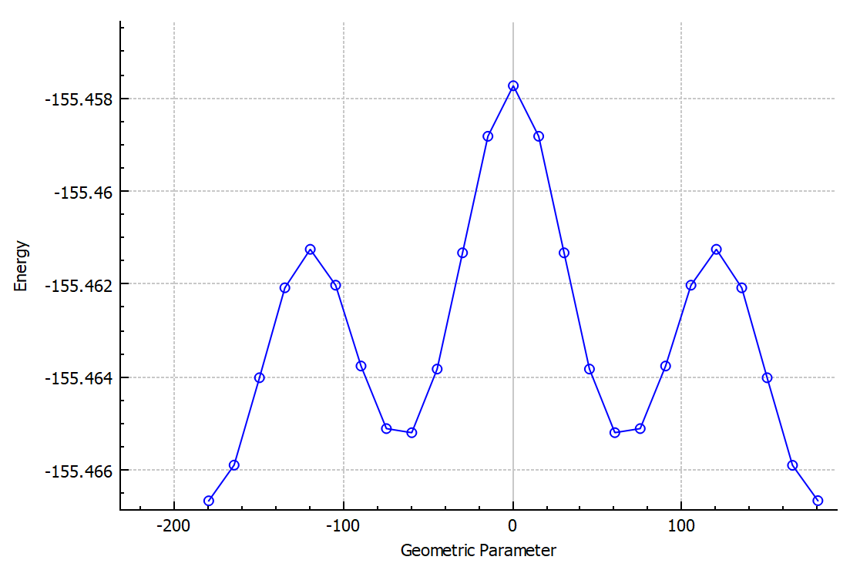
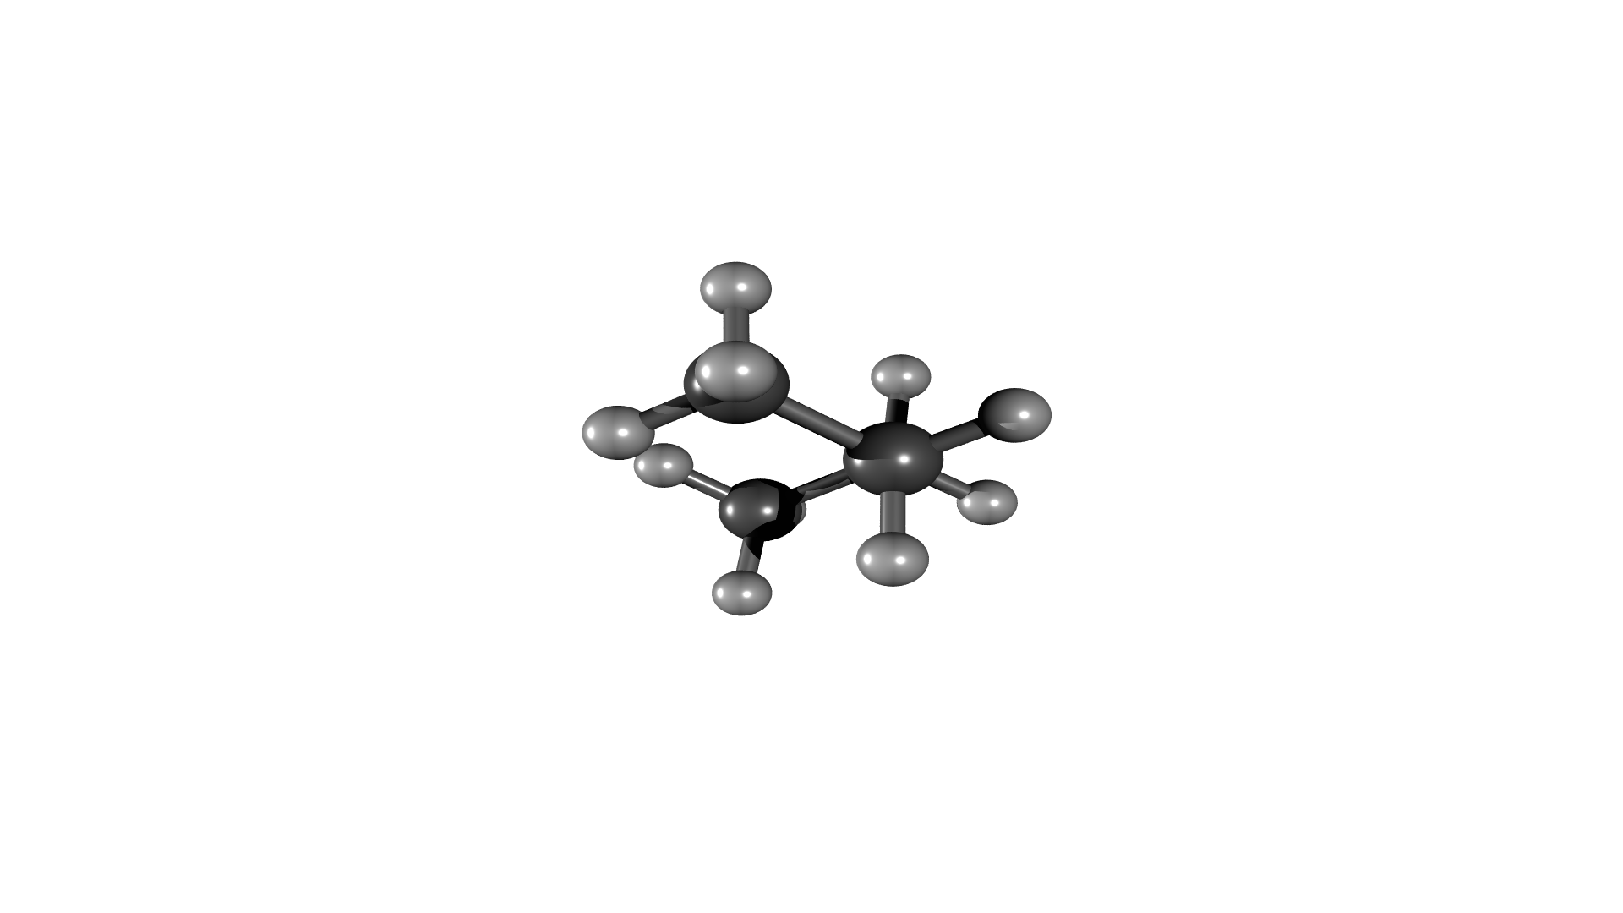
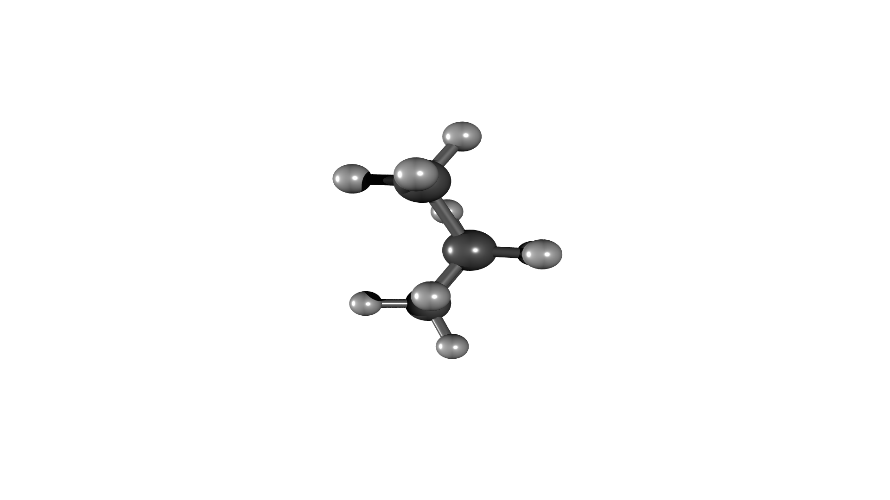
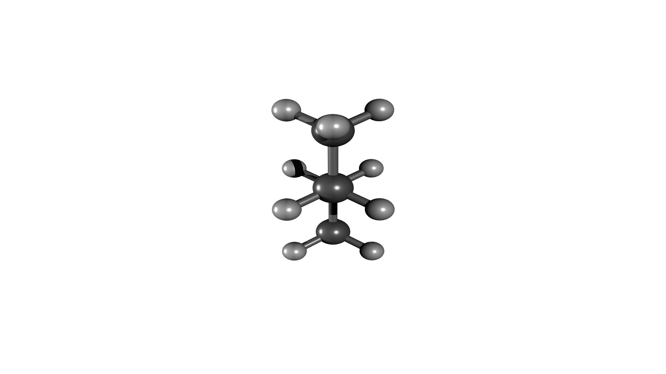
Results for Potential Energy Scan: Butane

